Slide 1
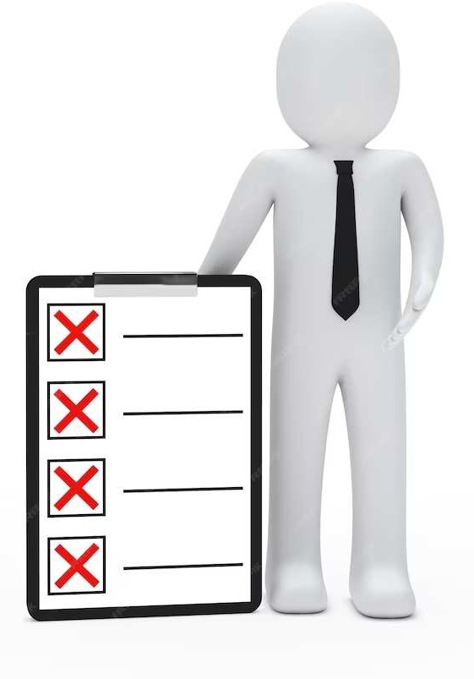
MINI-PROJECT To-Do List App

Slide 2
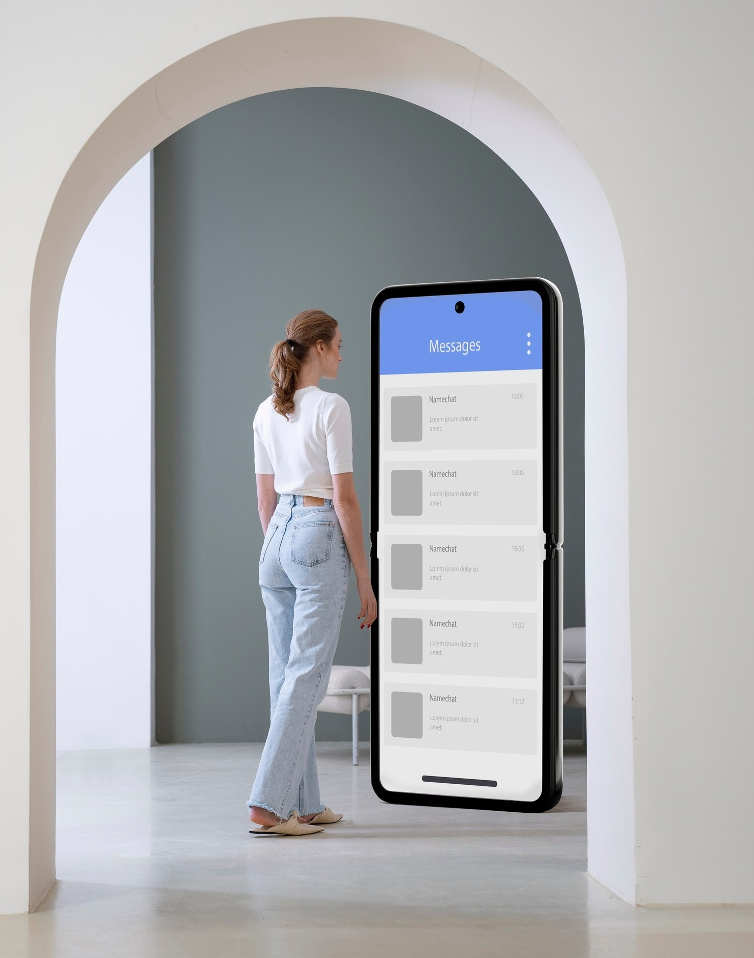
Introduction
An overview of to-do list apps We live in a time where complexity can be overwhelming. The Smart To-Do List embraces simplicity as its guiding principle, ensuring that anyone, regardless of tech-savviness, can seamlessly manage their tasks. It's not just about creating a checklist; it's about creating a smarter, more organized you.

Slide 3

WORKING
1. User Interface:
Minimalistic and user-friendly design.
2. Styling:
Dynamic styling with CSS variables for easy customization.
3. Task Management:
Task Addition:
Input field and "Add task" button for task entry.
Task Display:
Well-organized display of tasks in individual containers.
Task Actions:
Edit and delete buttons for task management.
4. Editing Tasks:
"Edit" button toggles to "Save" for seamless task modification.

Slide 4

WORKING
5. Task Deletion:
"Delete" button removes tasks from the list.
6. Visual Cues:
Completed Task Styling:
Visual cue for completed tasks with line-through text decoration.
7. Responsive Design:
Ensures consistent user experience across different devices.
8. Input Handling:
Read-Only Task Input:
Input becomes read-only after saving or adding a task.

Slide 5
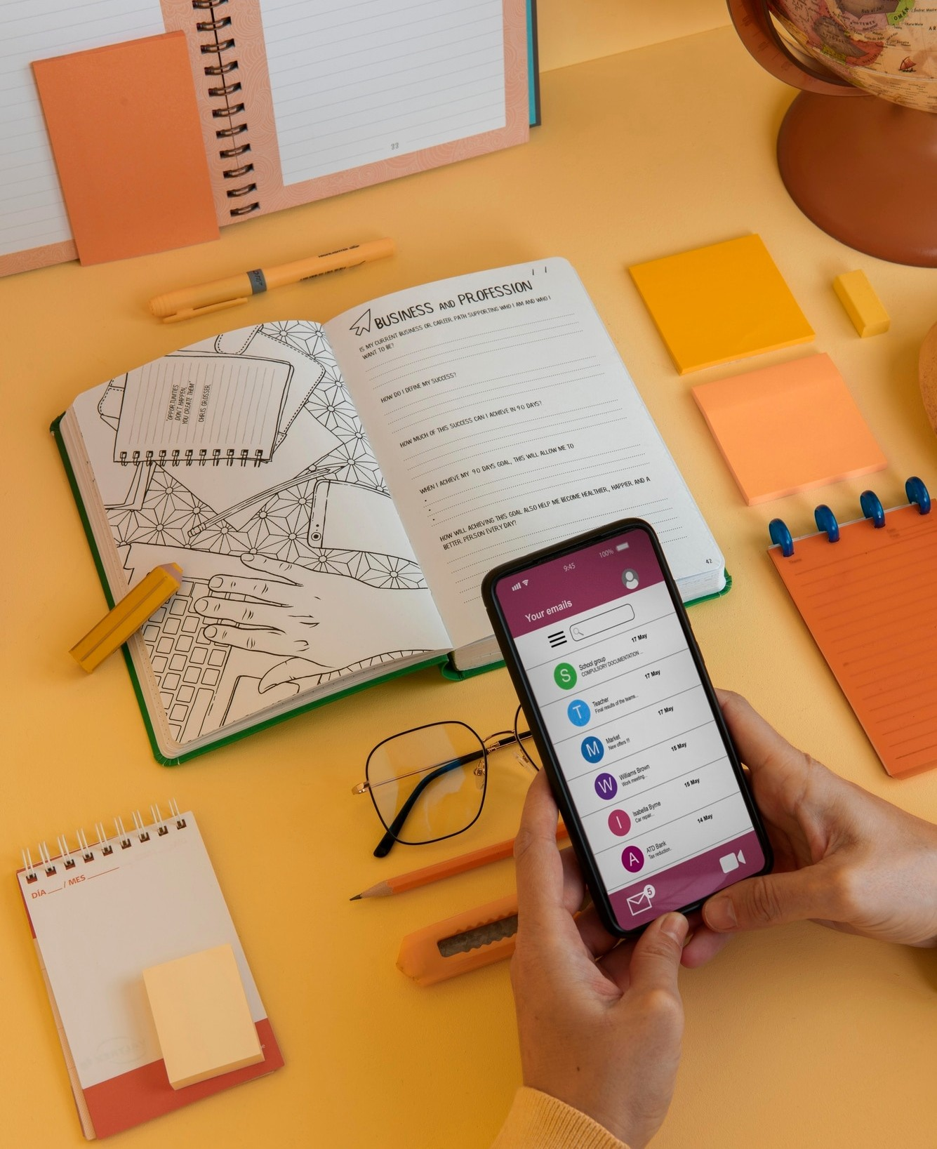
USES
Task Organization:
Efficiently manage and organize tasks.
Productivity Boost:
Prioritize tasks to enhance overall productivity.
Time Management:
Allocate time effectively using deadlines.
Collaboration:
Collaborate on tasks, especially useful for teamwork.
Goal Tracking:
Track and achieve personal or professional goals.

Slide 6

Collaboration Tools
Advantages:
Efficiency:
Streamlines task management, leading to increased efficiency and productivity.
Organization:
Provides a structured approach to organizing tasks, reducing chaos and improving clarity.
Time Management:
Facilitates effective time management by setting deadlines and priorities.
Disadvantages:
Dependency on Technology:
Relies on technology, making users dependent on devices and internet connectivity.
Learning Curve:

Slide 7
Thanks! To VaultOfCodes

